Slide 1

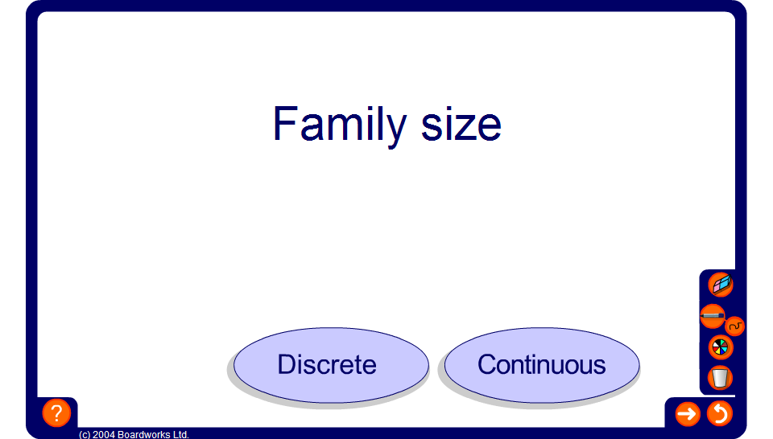


Discrete or continuous data
Notes:
Use this activity to review the difference between discrete and continuous data.

